Slide 1






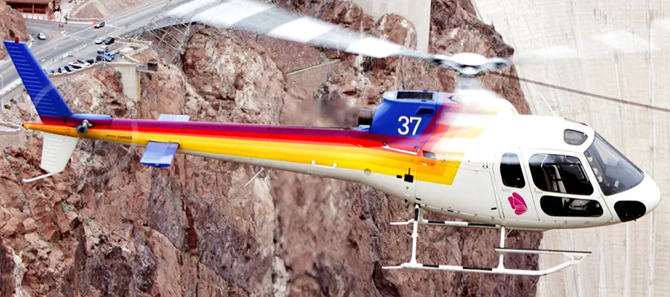
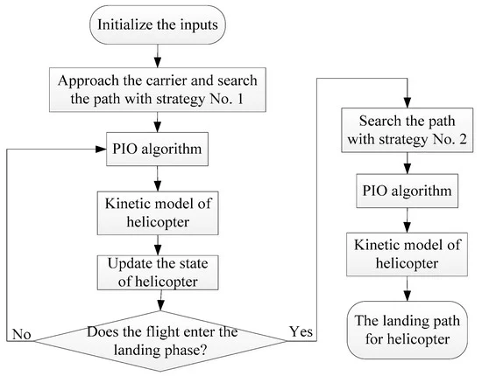
SKYSRAPPER HELICOPTER LIFTING
N.Akshitha,L.DivyaSri,K.Unnatha,P.Supriya
Dr.K.Kavita
Objective
Helicopters are introduced on the aircraft carrier to perform the tasks which are beyond the capability of fixed-wing aircraft. Unlike fixed-wing aircraft, the landing path of helicopters is not regulated and can be determined autonomously, and the path planning problem for autonomous landing of helicopters on the carrier is studied in this paper. To solve the problem, the returning flight is divided into two phases, that is, approaching the carrier and landing on the flight deck. The feature of each phase is depicted, and the conceptual model is built on this basis to provide a general frame and idea of solving the problem. In the established mathematical model, the path planning problem is formulated into an optimization problem, and the constraints are classified by the characteristics of the helicopter and the task requirements. The goal is to reduce the terminal position error and the impact between the helicopter and the flight deck.
The goal is to minimize the distance between the touchdown point and the original takeoff point, subject to impact speed limits at touchdown. Another important issue during helicopter landing is to reduce ground noise
Introduction
Helicopters are also introduced on the carrier to perform the tasks which are beyond the capability of fixed-wing aircraft, such as sea rescue, transportation, and antisubmarine warfare. One of the biggest advantages is that helicopters do not occupy the resource of runways, which reduces the waiting time of fixed-wing aircraft in the air
A helicopter works on the principle of aerodynamic lift - an upwards force that opposes the
weight of the helicopter and holds it the air. So how exactly do the rotors of helicopters
help them fly
Model and Performance Constraints of Helicopter :
Simplified kinematic model of helicopter is used, and a more complicated form of equations can be further considered in the design of a landing controller.
Firstly, a coordinate system must be defined to describe the motion of the helicopter and the carrier.
The coordinate origin O is fixed and is defined as the initial position of the ideal landing point, and the axis Ox points to the direction where the carrier sails. The axis Oz is vertically downward, and the axis Oy can be determined by the right-hand rule. Under the above coordinate system, (x, y, z) and (Vx, Vy, Vz) are the position and the velocity of helicopter in each direction, and φ is the angle.
In this path planning problem, x, y, z, φ are the state variables and can be denoted as the vector x=[xyzφ]. Vx, Vy and Vz are the control variables to be optimized and can be expressed as u=[Vx Vy Vz].
Note that in different flight phases, the control variables are not always the same.
For example : when the helicopter is approaching the carrier, the flight altitude remains unchanged. In this phase, Vz = 0 and only Vx and Vy are the control variables. While in the landing phase, all of the three control variables need to be optimized to make a precise landing.
In the landing task, the helicopter must fly within its maneuverability.
The performance constraints imposed on the helicopter can be denoted as follow:
Vx≤Vmaxx (1)
Vy≤Vmaxy (2)
Vz≤Vmaxz (3)
axy≤amaxxy (4)
az≤amaxz (5)
In the above five equations, the flight velocity in each direction is constrained by Equations (1)–(3). Equations (4) and (5) are added to limit the acceleration in the plane xOy and axis Oz, and axy=V˙2x+V˙2y
Constraints Regarding the Landing Task
In the landing task, certain constraints must be imposed on the state of helicopter to meet the task requirements.
These constraints are described as follow:
Determination of the feasible flying space
To ensure the safety of the landing task, the no-fly zone is set to avoid the helicopter disturbing the normal landing of the fixed-wing aircraft or even colliding with the fixed-wing aircraft. Additionally, the wind field in the near space of the carrier also affects the landing of the helicopter. The position of the helicopter cannot be ahead of the carrier in the Ox direction, or the landing task will fail. Those constraints limit the position of the helicopter
LIST OF HOW PILOTS USE MATH:
1. To note altitude
2. To note speed and wind speed
3. To know the average speed to get to the destination at the right time
4. Longitude and latitude
5. Distance form projectiles , obstacles or other aircrafts.
Notes:
MORE NOTES! PLEASE READ (Nov. 20th, 2005)
SCNT and Activation Parthenogenesis seems a bit redundant in that the first part kind of describes the technique already and then it is explained again in the figure caption. Also, should we not say that the embryos are destroyed when cells of the ICM are removed?
3) ET means ‘embryo transfer’? What does it mean (from our stand point) that this may be considered a medical advancement. Does that outweigh the concern that they may be instrumentalized or does it imply that the concern will be overshadowed by this “perceived” benefit, ie. could be used to coerce people to subscribe to this method of AR so that science can produce more hES lines? Think it’s not clear what is being said there.
4) Not sure if you actually want to use the example of Meissner and Jaenisch here but I just put in a little argument which I did not think through totally but it’s there for you to work with.
Solutions:
1) Not sure if you just wanted to outline Eggan’s technique here? I assumed so and deleted the rest so it would fit. Do we have to reference on a poster?
(Nov. 19th, 2005)
Zubin, I will just outline quickly here some of the things I noted today and I told you about on the phone:
Lanza abstract says: “The most basic objection to human embryonic stem (ES) cell research is rooted in the fact that ES cell derivation deprives
embryos of any further potential to develop into a complete human being^{1,2}.” Meissner and Jaenisch also makes reference only to destruction.
Is there somewhere we can say that yes this is a pertinent objection but certainly not the only objection and maybe not even the most basic objection. There are two distinctive criteria to satisfy: 1. not destroy the embryo 2. not treat them as instruments (which probably can’t avoid unless avoid embryological source altogether as you suggest). I tried to outline this in “The Moral Status of the Human Embryo”
There is also the issue of viability and “pseudo-embryos”, I think Baylis is wrong to draw the moral demarcation line where she does. She gives examples of what she thinks is non-viable: multipronucleate embryos, parthenogenetically activated eggs without fertilization, numerical/structural chromosomal abnormalities, genetic mutations, poor morphological quality….all of these are morally equivalent to a somatic cell? What do you think? Should this be addressed under 4) if at all? Meissner and Jaenisch are trying to pull the biological artifact fast one too, with their altered nuclear transfer method of turning off the cdx2 gene and thereby producing a non-viable embryo. Can’t be that easy to change the moral status…seems like a façade, especially since might be able to turn it back on in the hESC derived from that embryo. It seems we are intentionally holding it in that non-viable state and how is that any better (or any different) than destroying a viable embryo?
The moral philosopher Mary Warnock of Britain (I read this in the Jasanoff book) managed to created a space of authorized research on embryos by drawing a demarcation line at the 14-day old period when there is the first appearance of a “primitive streak”. This entity was excluded from the boundary of personhood. This seems wrong but I also don’t want to imply in this poster that abortion rights should be rolled back! Hard to reconcile with a permissive abortion law.
Baylis also raises another interesting question (but this may be beyond the scope of this paper)…suppose we achieve hESC production in an ethical manner, what then? Will women be coerced and exploited by this new technology? Will it be costly and benefit only a privileged few? Eugenics? Nevermind the moral status of the embryo, maybe one of these ethical consequences is reason enough not to pursue hESC research.
These are all just things that have come up in the last day, don’t need to incorporate or deal with them totally for this conference but probably for the paper.

